Slide 1
Fraud Prevention
Project#9

Slide 2
Team Members
Nawazuddin Mohammed
Oli Saffiullah: work part of customer success team for a company that does machine learning automation
Muhammad Qadri
Haaris Rehman
Nadir: I work as lead developer in financial industry and have 14 years experience in different technologies: sql, cobol, C , python on ibm I, unix & windows platform. I did engineering in electronics and I am based in Indiana- central time zone.
Serkan Kaya
Mohammed Hmimou: field of study is geomatics
(781)XXX-XXXX
Kusay Rukieh: I am in the IT industry for 20 years support multiple roles. I would love to move to data science field.

Slide 3
Project Background
Banking and financial industries are facing severe challenges in the form of fraudulent transactions. Credit card fraud is one example of them. In order to detect credit card fraud these finical institution resort to Big Data.
Companies that utilize big data can dramatically enhance their fraud detection. For example, credit card companies can use data analytics to compare the geographical locations of credit card transaction, a method called geolocation. Geolocation information If two in-person card payments occur in different locations without enough time having elapsed for the customer to travel between them, the credit card company can automatically flag the activity as indicative of fraud. By including additional types of data in the model, companies can further improve fraud detection accuracy.
To try to catch all instances of fraud, a credit card company would have to stop every transaction and put them through a detailed examination before approving. This would of course create a terrible experience for cardholders. On the other hand, if the credit card company were to simply approve all transactions without checking for fraud, it would likely go out of business with the steady losses, and cardholders would be forced to look elsewhere. At the end of the day, it’s important to optimize for these competing demands and reach for a happy medium.
Detecting fraud involves understanding that every cardholder has a different pattern of usage, so you need to build fraud detection models specific to each cardholder. For instance, a frequent flyer will need a looser geographic “fence” for fraud detection than a cardholder who travels infrequently. Other data points—the types of businesses a person frequents, the amounts of monthly bills over time (accounting for seasonal bumps), financial resources that the model can verify—can all be useful in building a more intelligent model.

Slide 4
Data Sets/Observations
The Data sets exist in the following file:
ecom_txns.csv.
Data Dictionary:
user_id - Unique ID for the user.
signup_datetime - First time the user signed up for the site.
datetime - First time the user made a purchase.
amount - Amount of purchase.
device_id - Unique ID of the user's device.
store - E-commerce property (babies, toys, or pets)
browser - User's browser.
sex - User's gender.
age - User's age.
ip_address - User's IP address.
fraud - Was the transaction fraudulent or not?

Slide 5
Questions to ask (5)
Browser type is used for the transaction?
Geolocation information of the transaction ( ip address)?
Geo-timing of the transaction (datetime)
Age of the user?
Ecommerce website used (toys, babies, pets)?

Slide 6
Data Understanding
EDA statistical analysis using R and data visualization using tableau

Slide 7
Analytical Approach
Classification Analyses because:
Type of Target variable “fraud” is binary 0/1
Type of business question: predict a transaction is fraudulent or not
Measure of Success:
Confusion Matrix
PCC

Slide 8
Code book
Structured Data in flat file csv
150000 observations with 12 features
Target variable “Fraud” loaded in R as int instead of factor. So transform it to factor.
TV “Fraud” is unbalanced: (90%) 0:135957 & (10%) 1: 14043. So either use imbalanced data with F1 Measure or balance it using Over/Under sampling.
211,358 observations of ip_mappings.csv with badly formatted Start_ip (like fec0::) and end_ip (like ffff:ffff:ffff:ffff:ffff:ffff:ffff:ffff). So go back to source and recollect correct data.
Feature “Sex” have 90,057 (60%) as “Not Provided”. So Use it as a category for prediction.
Skewness of “Amount” = 0.67 and of “Age” = 0.42. So transform using John tukey ladder to fix skewness

Slide 9
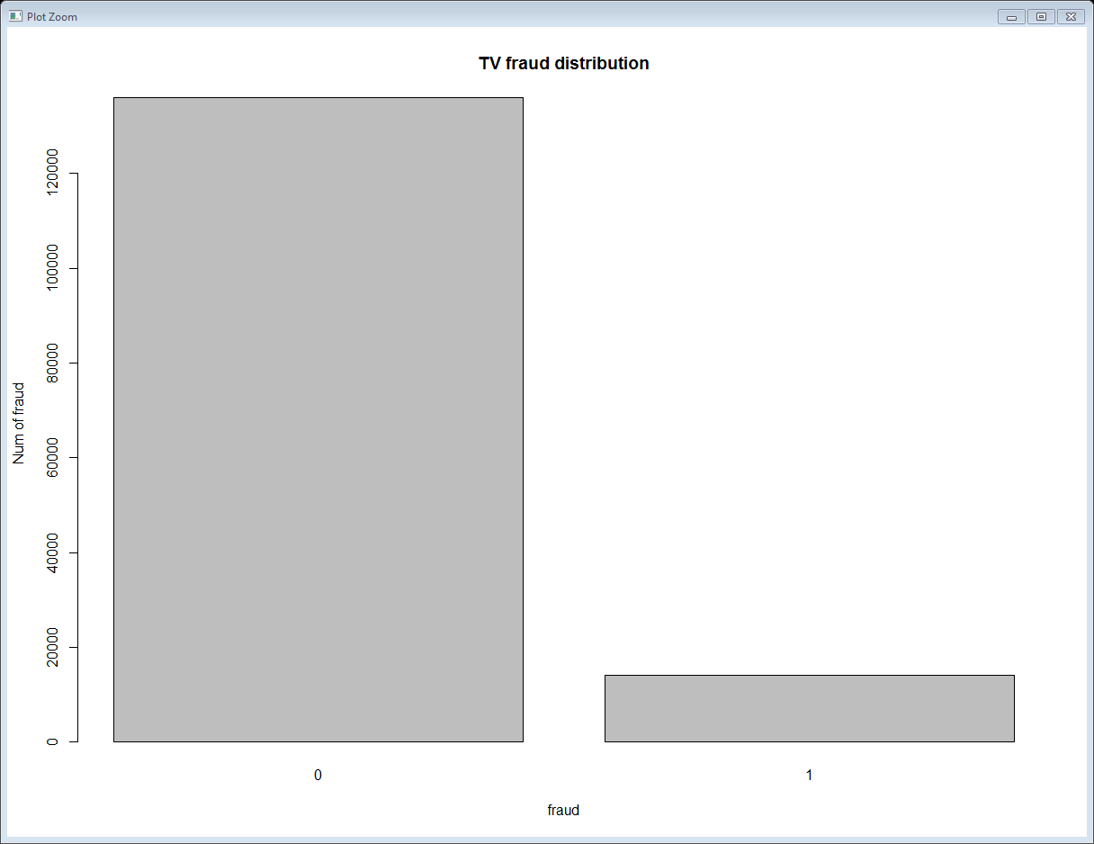
Data Visualization (Bar graph)

Slide 10
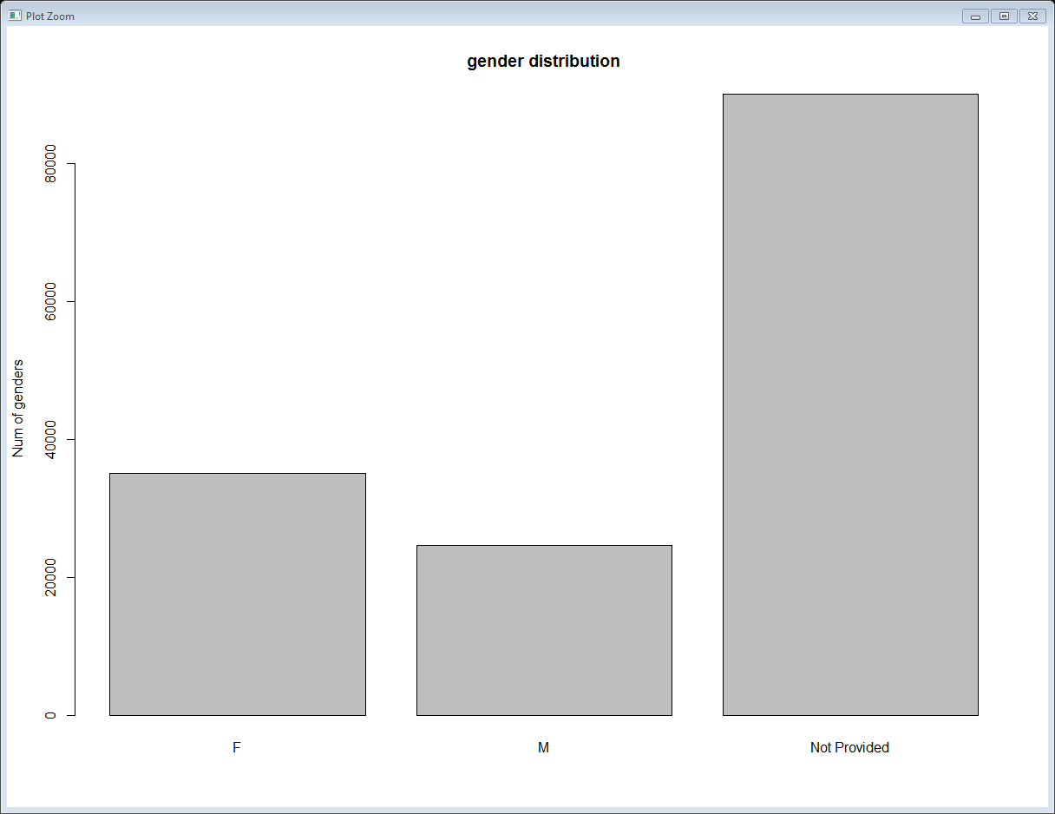
Data Visualization(Bar graph)

Slide 11
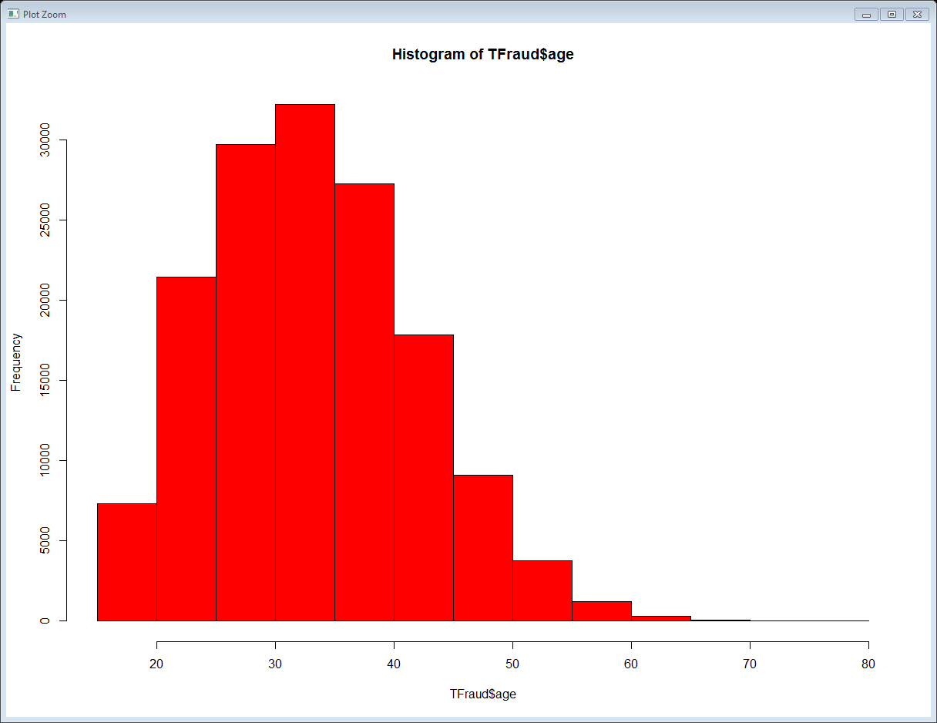
Data Visualization(Histogram)

Slide 12
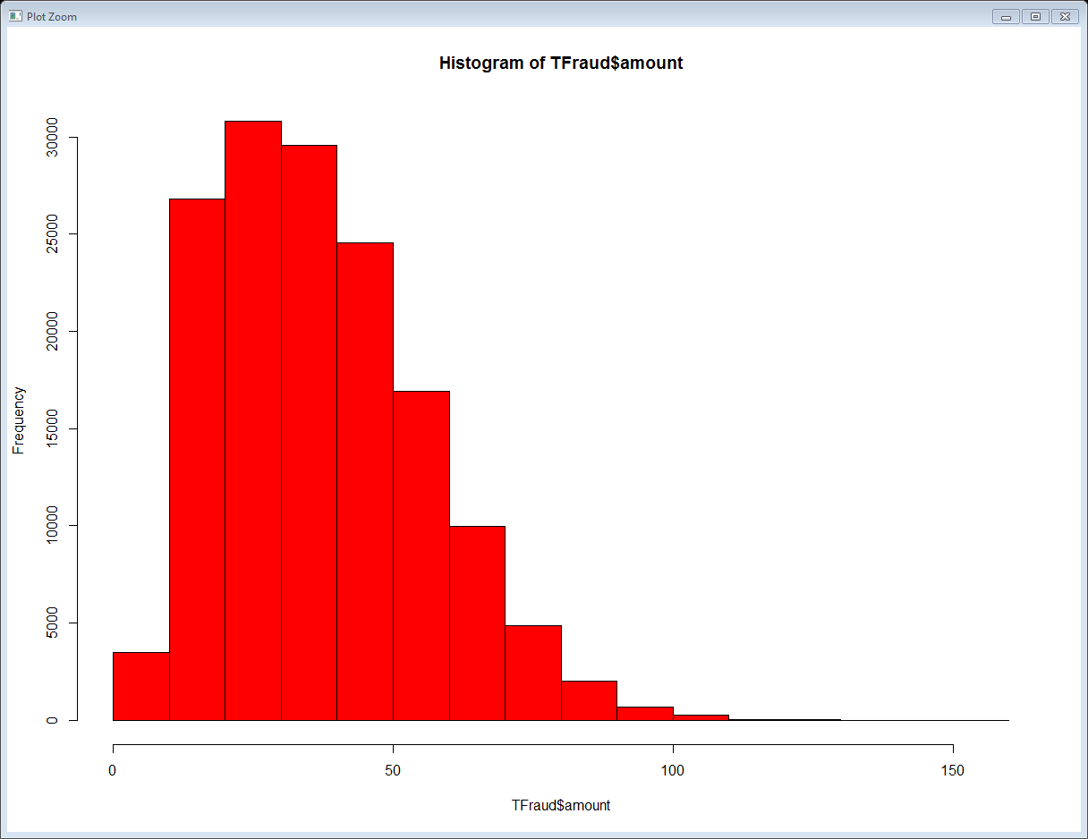
Data Visualization(Histogram)

Slide 13
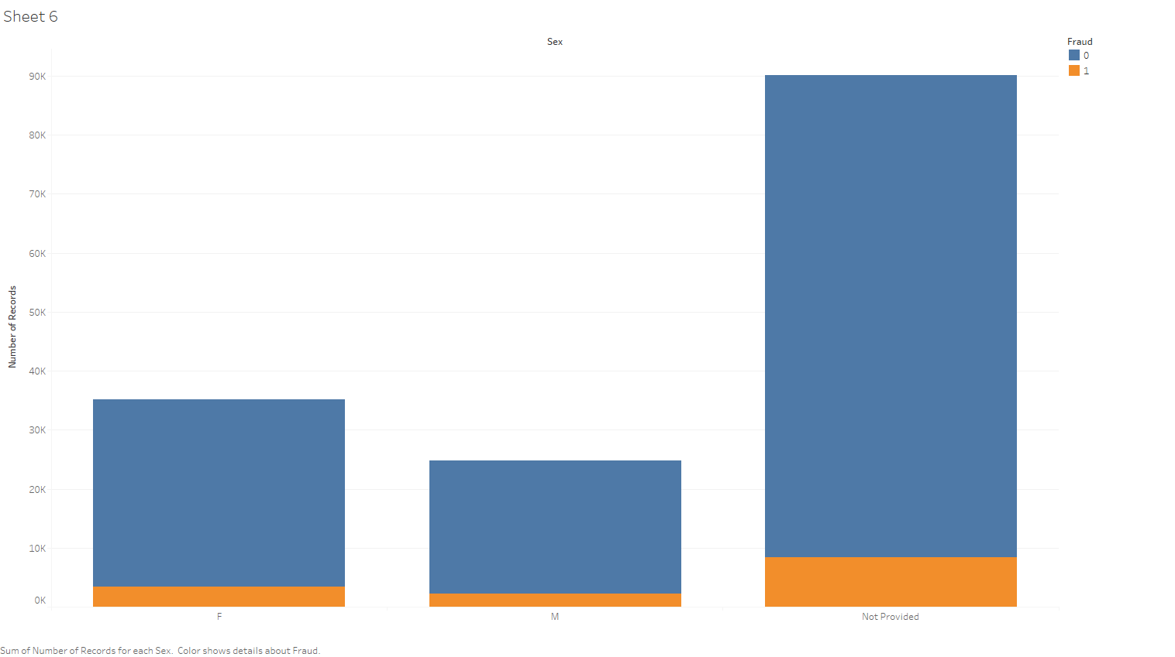
Data Visualization

Slide 14
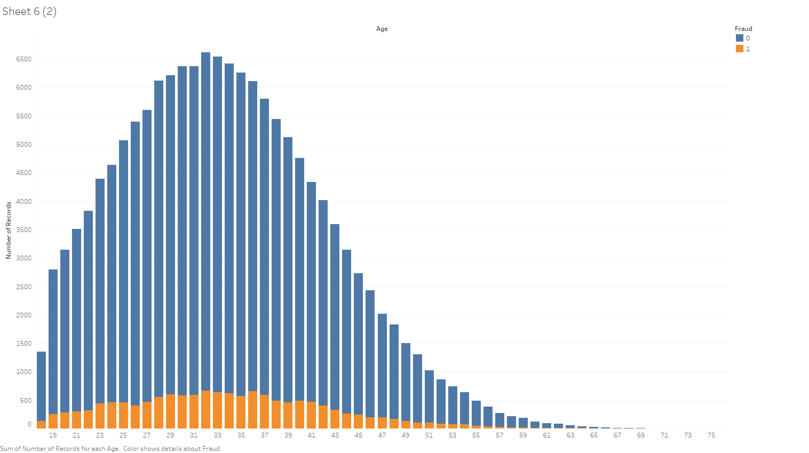
Data Visualization

Slide 15
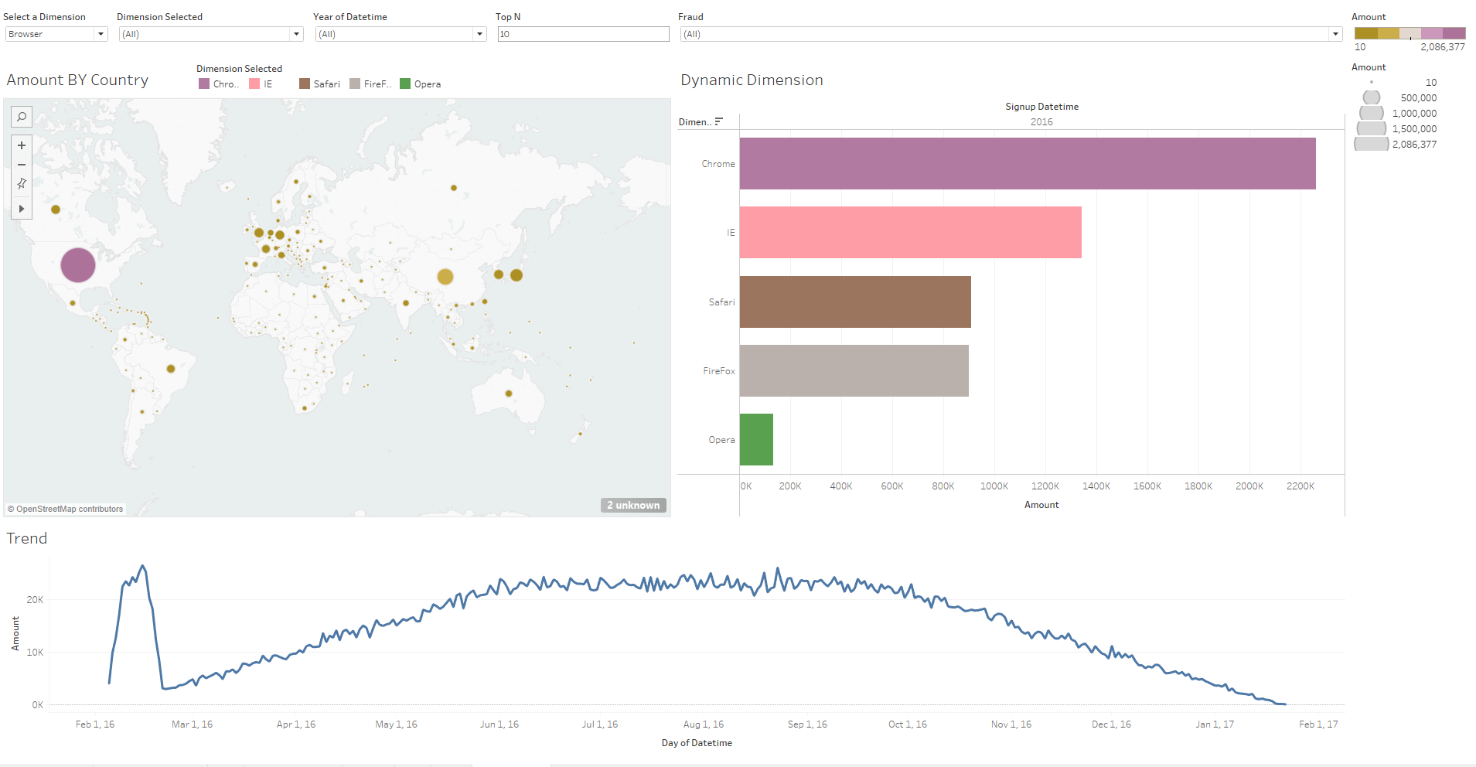
Data Visualization

Slide 16
Data Models Comparison
Model |  | Decision Tree |  |  | Naïve Bayes |  |  | KNN |  |  | Logistic Regression |  |  | K-SVM
 |  | 0 | 1
Confusion Matrix | 0 | 27098 | 93 |  | 27191 | 0 |  | 27142 | 49 |  | 27191 | 0
 | 1 | 1314 | 1495 |  | 2809 | 0 |  | 2609 | 200 |  | 2809 | 0
Accuracy |  | 0.9531 |  |  | 0.9063 |  |  | 0.9114 |  |  | 0.9063
Performance Time |  | slow |  |  | fast |  |  | VERY SLOW (3 min) |  |  | fast
Type I Error |  | 93 |  |  | 0 |  |  |  |  |  | 0
Type II Error |  | 1314 |  |  | 2809 |  |  |  |  |  | 2809
Precision |  | 0.954 | 0.941 |  | 0.906 | Nan
Recall |  | 0.997 | 0.532 |  | 1 | 0
F1 Score (Unbalanced TV) |  | 0.975 | 0.68 |  | 0.951 | NaN |  | 0.953 | 0.131 |  | 0.951 | 1.658
Best Model: | ??
Why? | ??

